Slide 1
NLP BBC Project
George Antonakis · Samuel Cook · Orestis Pappas

Slide 2
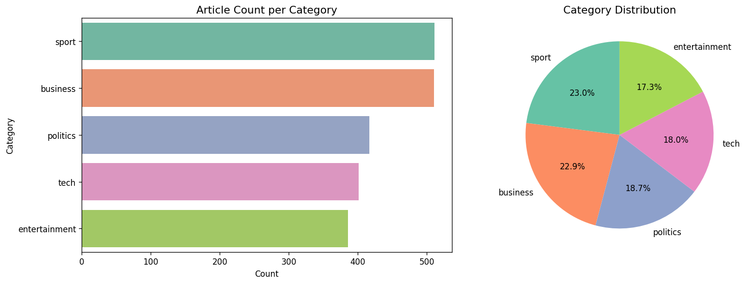
What is our project
end-to-end NLP pipeline built on the BBC News dataset
2,225 news articles from 2004 and 2005
five categories: business, entertainment, politics, sport, and tech.
The data comes from HuggingFace's
The categories are reasonably balanced — sport and business are the largest, tech and entertainment slightly smaller, but no category dominates.

Slide 3
Preprocessing
Lowercase
Strip URLs & HTML
Expand contractions
Remove punctuation
Remove stopwords
Lemmatise
0
missing values
− 99
duplicates removed
2,126
articles kept
Lemmatise, not stem — real words downstream
Two text versions kept: cleaned for our models, raw for DistilBERT
Notes:
Cleaning: we checked for missing values (none) and removed 99 duplicate or near-duplicate articles, leaving 2,126.
Pipeline: lowercase, strip URLs and HTML tags, expand contractions, remove punctuation, remove stopwords, lemmatise.
We chose lemmatisation over stemming deliberately: stemming can mangle words into non-words, which hurts readability of everything downstream, especially our topic model's keyword lists and our word-embedding neighbours.
We kept two versions of the text throughout the whole project: the original raw text and this cleaned version. Our from-scratch models want the cleaned version, but our pretrained transformer, DistilBERT, performs better on the original uncleaned text, because it has its own subword tokenizer that already knows how to handle punctuation and capitalisation.

Slide 4
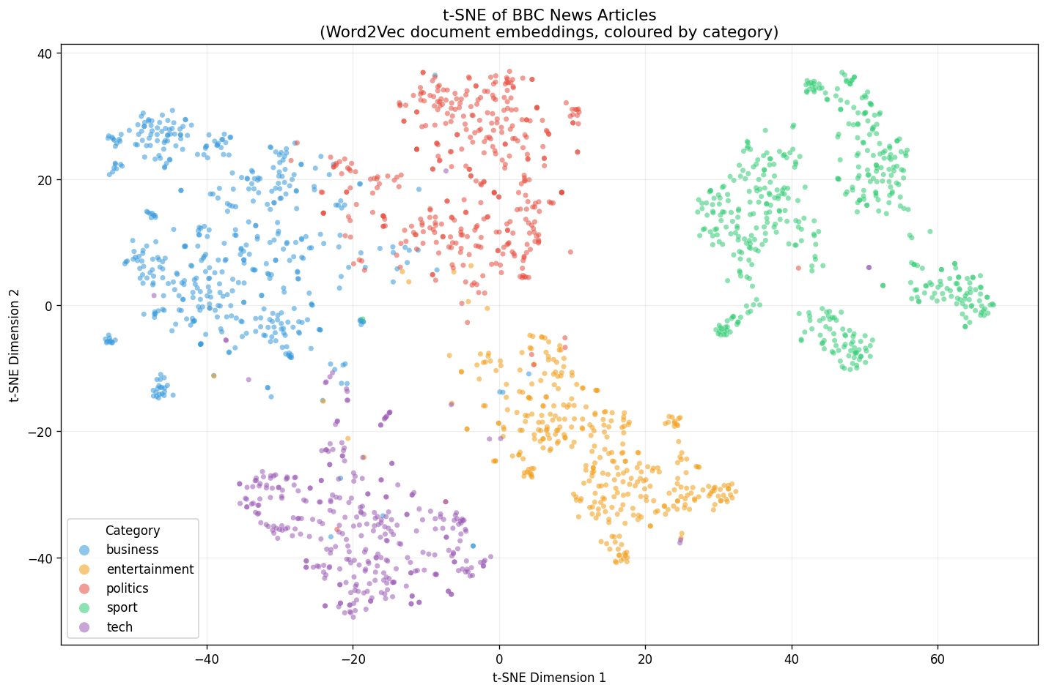
Feature Engineering
To visualise the embedding space, we projected our 100-dimensional Word2Vec document vectors down to 2D using t-SNE, coloured by category
Built three feature representations
A TF-IDF matrix
Word2Vec model
Trained from scratch on our own corpus
Averaged Word2Vec vectors
As one deliverable, we built a function that takes any word and returns its most similar words by embedding distance.

Slide 5
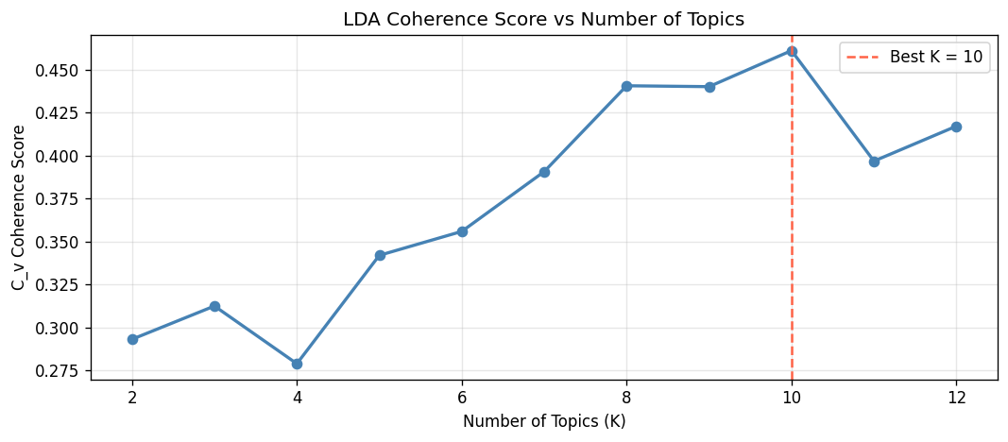
Topic Modelling (Unsupervised)
Double our number of known categories.
LDA split several of our categories into finer sub-themes.
That's not a failure — it's the unsupervised method finding real structure inside our categories that the human labels don't capture.
For unsupervised learning, we used Latent Dirichlet Allocation (LDA)
We trained models for every K from 2 to 12 and scored each using coherence
Found K equals 10 gave the best score.

Slide 6
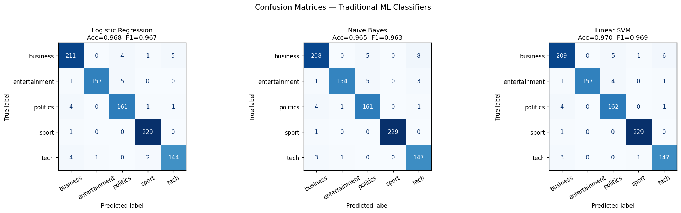
Text Classification (Supervised)
We trained three classical models on TF-IDF features
Logistic Regression,
Naive Bayes,
linear Support Vector Machine
TF-IDF on the training data only, to avoid any information leaking from the test set.
All three performed extremely well — between 96.5% and 97% accuracy.
Linear SVM was the best of the three, at 97.0% accuracy and 0.969 macro F1.

Slide 7
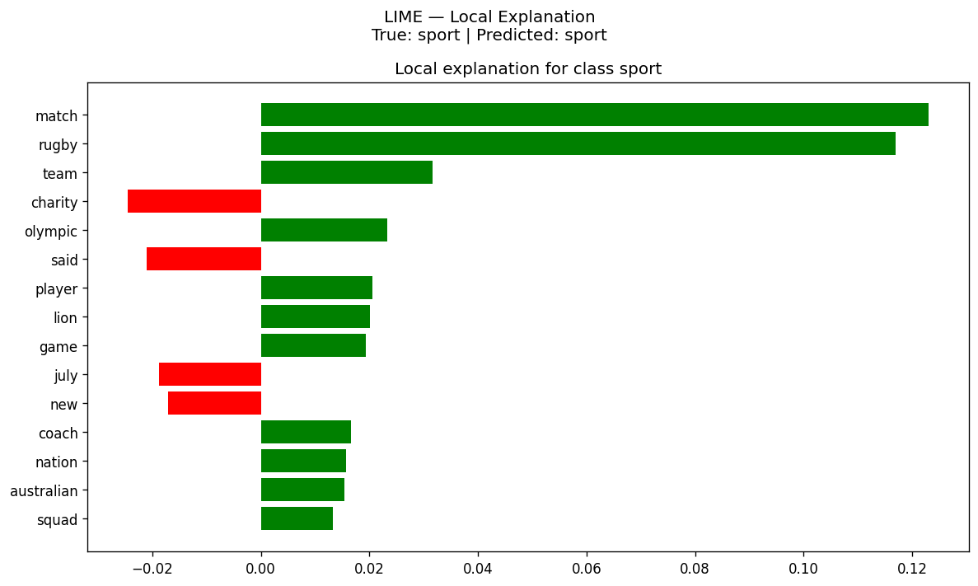
Explainability
Local Interpretable Model-agnostic Explanations (LIME)
Explains one prediction at a time by showing which words pushed the model toward its answer.
LIME highlights the specific words that drove the sport prediction.
We also looked at a misclassified example to understand where the model gets confused.
Giving us both a local and a global view of what the model has learned.

Slide 8
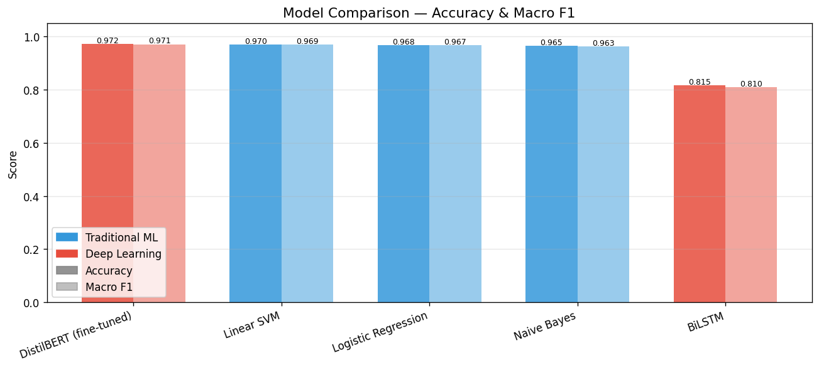
Deep Learning
DISTILBERT
Bidirectional LSTM
Then we fine-tuned DistilBERT
a compressed, pretrained transformer
This reached 97.2% accuracy and 0.971 macro F1
Bidirectional LSTM
No pretrained embeddings
'From scratch' deep learning model compares to classical machine learning.
It reached 81.6% accuracy
Beaten by Naive Bayes, the simplest model we tried.

Slide 9
Model Comparison — All Five Classifiers
Model | Type | Accuracy | Macro F1
DistilBERT (fine-tuned) | Deep Learning | 97.21% | 0.971
Linear SVM | Traditional ML | 97.00% | 0.969
Logistic Regression | Traditional ML | 96.78% | 0.967
Naive Bayes | Traditional ML | 96.46% | 0.963
BiLSTM (from scratch) | Deep Learning | 81.55% | 0.810

Slide 10
Deep Learning Continued
97.2% vs 97.0% — a difference of two articles out of 932
The honest reading: a 67M-parameter transformer and a linear model over word counts are tied.
Pre-training does the work
DistilBERT adapts representations learned on billions of words
From scratch is not enough
the LSTM reaches 81.6% — beaten by Naive Bayes
No headroom left
'shares' or 'scored' alone settles the category
Notes:
Our two deep learning models are at opposite ends: DistilBERT at 97.2%, the LSTM at 81.6% — while DistilBERT and a bag-of-words SVM differ by 0.2.
DistilBERT starts from representations learned on billions of words and only has to learn the mapping onto five labels. The LSTM starts from random noise and has to learn what words mean and how to classify at the same time.
The transformer's advantage is understanding context and word sense — but BBC categories are so lexically distinct that the word 'shares' or the word 'scored' basically settles the answer on its own.
The margin matters: DistilBERT beats our Linear SVM by 0.21 percentage points. On a test set of 932 articles, that's a difference of two articles. The honest reading is that a 67-million-parameter transformer and a linear model over word counts are tied.

Slide 11
RAG
Retrieval-Augmented Generation system a chatbot that answers questions grounded in our article corpus, rather than making things up.
Two parts:
A Retriever
A Generator
We evaluated it on ten manually written questions about topics from the corpus.
Scoring the generated answers against expected answers with ROUGE-L
Our mean was 0.155, with a best of 0.31 and two questions scoring zero.

Slide 12
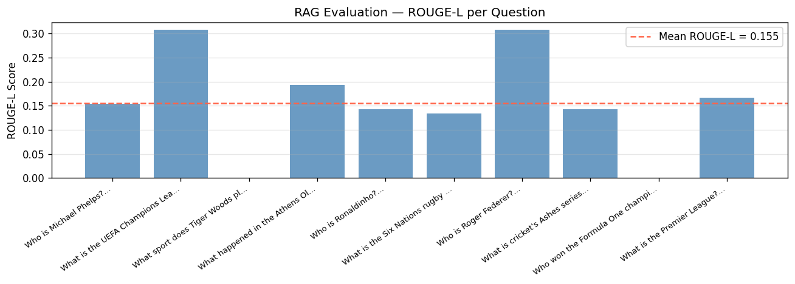
RAG — Evaluation Results
Mean ROUGE-L 0.155 · best 0.31 · two questions scored 0.0000
'What sport does Tiger Woods play?' → 'golf' — correct, scored 0.0000
Six of ten answers correct; the highest score any of them earned was 0.31

Slide 13
RAG Continued
One zero is the metric failing — the other is the system failing.
ROUGE-L gives them the same score: 0.0000
Metric failure
'golf' — correct
scored 0.0000
System failure
'ivanovic' — wrong
scored 0.0000
4 of 10 answers wrong
What we'd do instead
Recall@k for retrieval
BERTScore for answers
Notes:
ROUGE-L scores the longest common subsequence against a reference answer — it rewards wording overlap.
Metric failure: our reference for 'What sport does Tiger Woods play?' was the full sentence 'Tiger Woods is a professional golfer.' An instruction-tuned model asked a direct question answers tersely — it says 'golf'. That answer is completely correct, and it scores exactly zero, because 'golf' and 'golfer' are different tokens with no common subsequence.
System failure: our other zero is 'Who won the Formula One championship?' → 'ivanovic', which is simply wrong. Four of ten answers are factually wrong — a real limitation of a small generator. Flan-T5-base is small, so its answers are terse, and some of our own questions aren't answerable from this corpus.
What we should have done is measure retrieval and generation separately — Recall@k for the retriever, and score answers with something like BERTScore that credits correct paraphrases.
Retrieval itself is sound: when we query 'Who won the football championship?', it returns two relevant football articles — and a review of the video game Championship Manager, tagged tech. That third hit isn't a bug; it's evidence the retriever is matching on meaning rather than keywords, because it understood 'championship' in a sense our query never disambiguated.

Slide 14
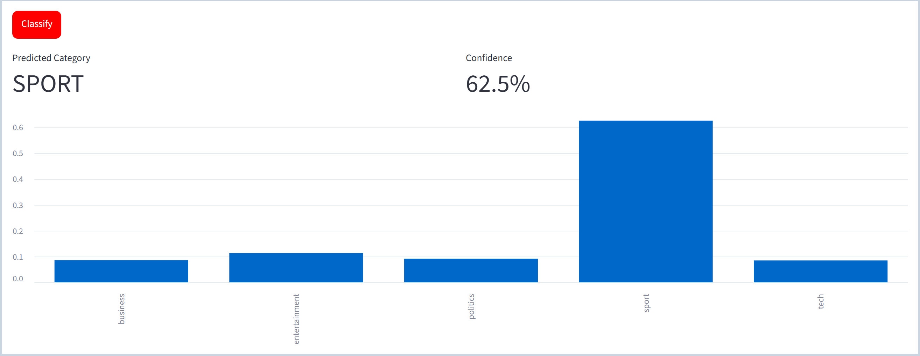
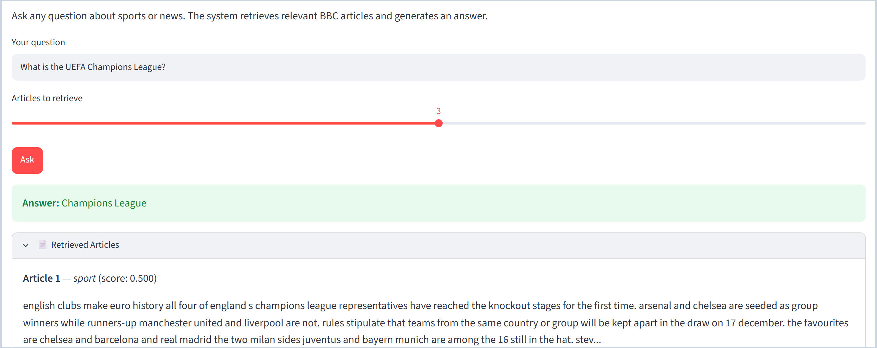
Streamlit
TAB 1
Where you paste any news text and get a live category prediction with confidence scores.
Tab 2
Where you can ask the RAG chatbot a question and see both its answer and the source articles it retrieved.
(Start Hopeful Live demonstration here)

Slide 15
Conclusion
Raw text → deployed chatbot
end-to-end, live on Streamlit
Seven techniques, one pipeline
topics · classifiers · deep learning · XAI · RAG
Pre-training, not depth
the leaderboard winner is not always the one to ship
Future work
GloVe/FastText init for the LSTM · separate retrieval / generation eval · a harder corpus (sarcasm, fine-grained sentiment)
Notes:
We built a complete pipeline from raw text to a deployed, working chatbot: unsupervised topic discovery, three classical classifiers, two deep learning approaches, an explainability layer, and a retrieval-based question-answering system.
Pre-training, not depth, is what separates these models — and the best model on the leaderboard isn't always the right model to ship.
Future work: the cleanest next experiment is to initialise that same LSTM from pretrained GloVe or FastText embeddings. We'd also rebuild the RAG evaluation to measure retrieval and generation separately, and test our 'no headroom' explanation on a harder corpus — something like sarcasm or fine-grained sentiment.

Slide 16
Thank You
Questions?

